Slide 1
Mapping Open Data
Jeff Ferzoco and Jessie Braden

Slide 2
Introductions Your projects Using maps and data to tell stories -GIS and web mapping -Maps we like -Our projects Tips and Guidelines -Visualization and cartography -Census data -NYC context Q&A and help session
Agenda
1:30-1:45 1:45-2:15 2:15-3:15
3:15-4:00
4:00-5:00

Slide 3

GIS and Webmapping
What is GIS?
GIS versus web mapping

Slide 4
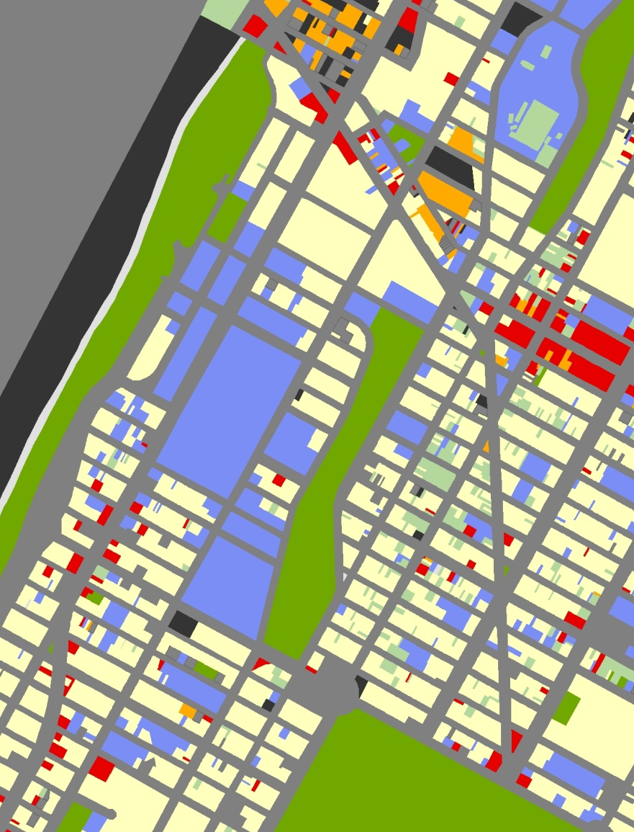
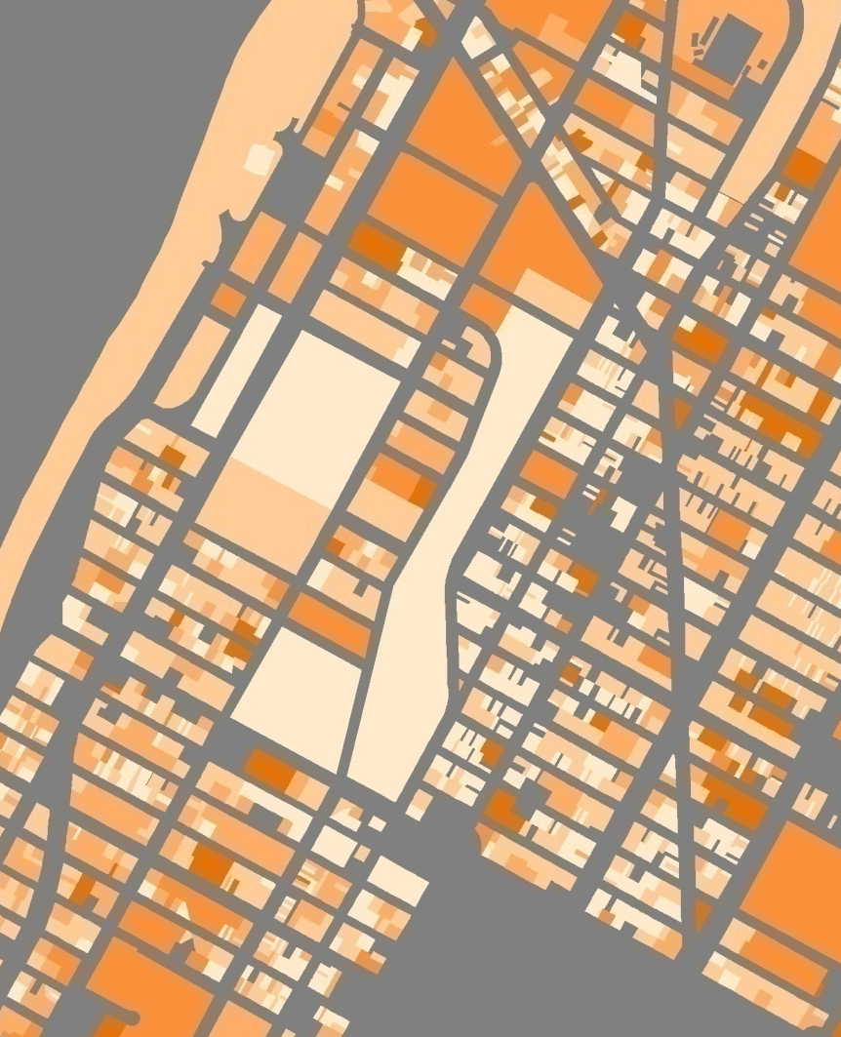
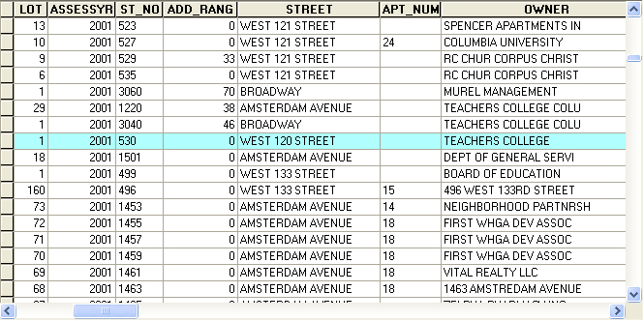
What is GIS?
Geographic Information Systems (GIS) are tools for managing data about:
where features are (geographic coordinate data) and what they are like (attribute data), and for providing the ability to query, manipulate, and analyze those data.
commercial industrial residential open space other transport institutional parking vacant

Slide 5
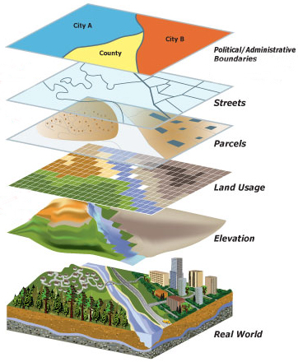
What is GIS?
Relationships:
water quality + local health data
temperature data + vegetation
population + elevation
land use + real-estate development
http://www.srh.noaa.gov/bmx/?n=gis

Slide 6
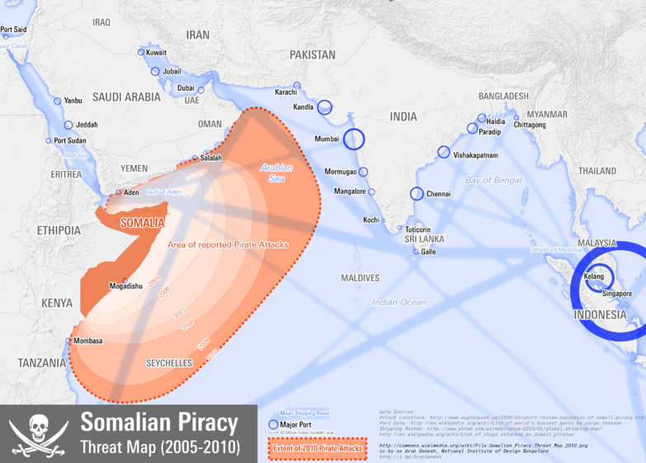
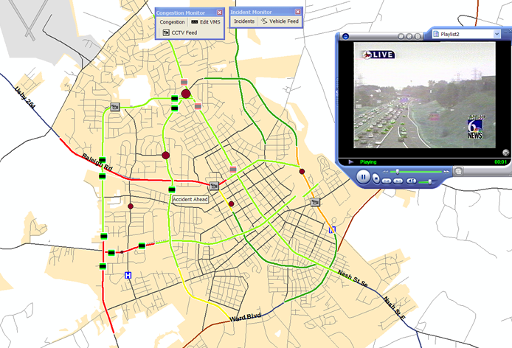
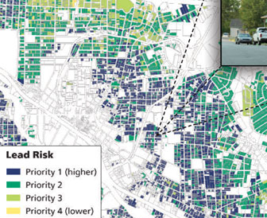
What is GIS?
Visualize
Ask questions
Context
Calculate and quantify
Inspect
Interpreting patterns
Public health
Retail
Planning and Architecture
Ecology
Transportation
Military

Slide 7
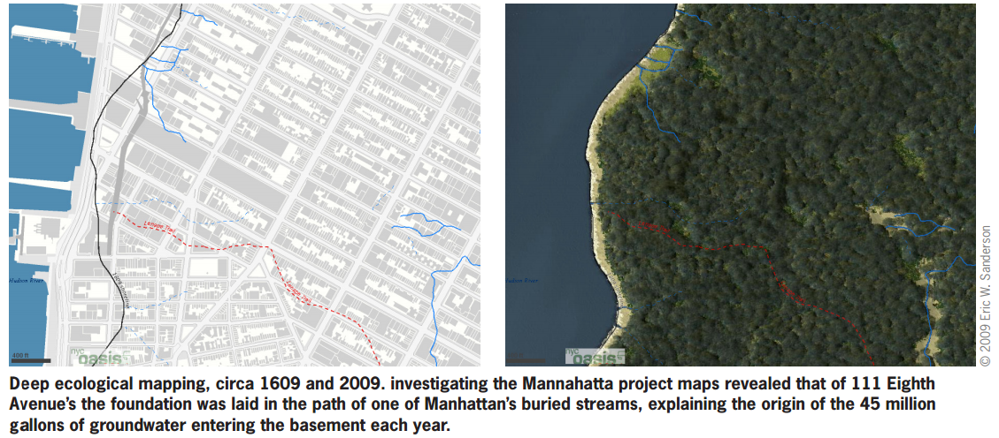
Making Connections with Maps
Notes:
http://www.terrapinbrightgreen.com/downloads/Terrapin_Deep%20Ecological%20History_2010.pdf
http://archpaper.com/uploads/ManahattaSplitSky.jpg
http://ijarcet.org/wp-content/uploads/IJARCET-VOL-3-ISSUE-3-636-641.pdf

Slide 8
GIS and web mapping

Slide 9
Maps we like

Slide 10
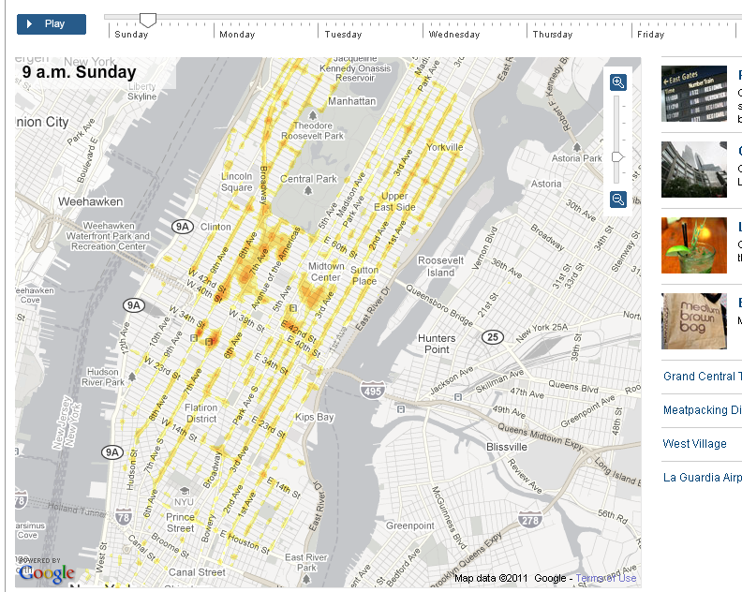
http://www.nytimes.com/interactive/2010/04/02/nyregion/taxi-map.html

Slide 11
Jeff’s projects

Slide 12
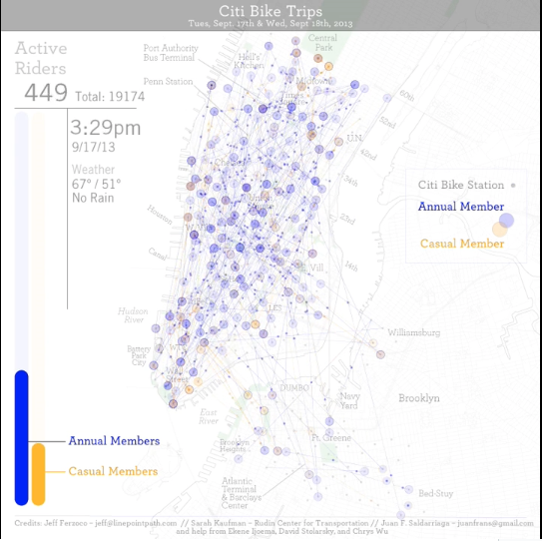

Slide 13
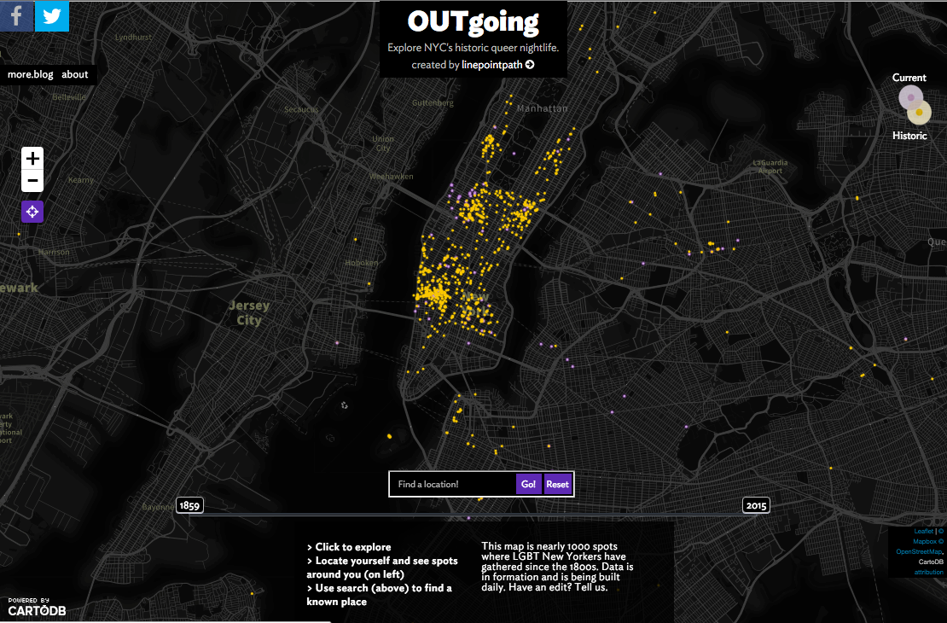

Slide 14
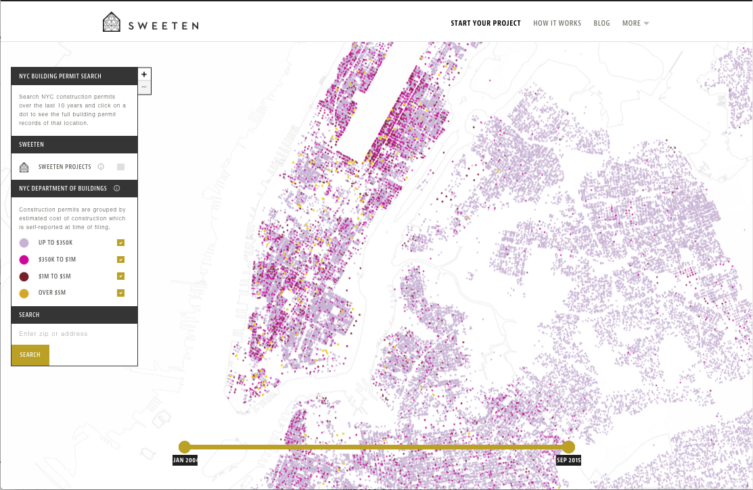

Slide 15
Jessie’s projects

Slide 16
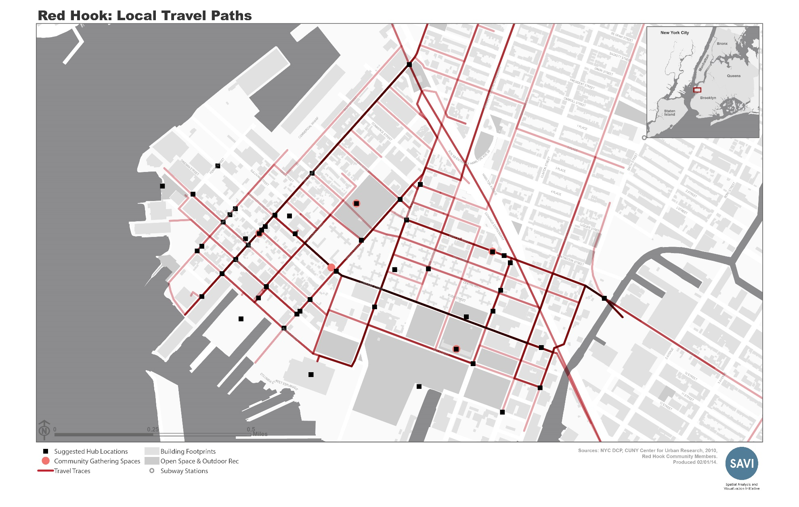

Slide 17
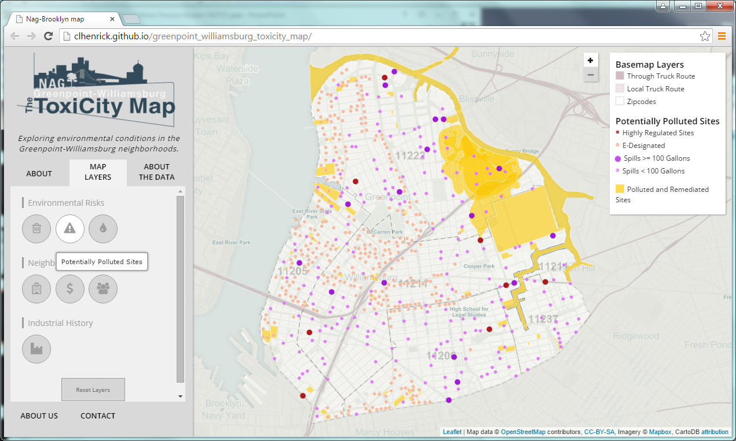

Slide 18
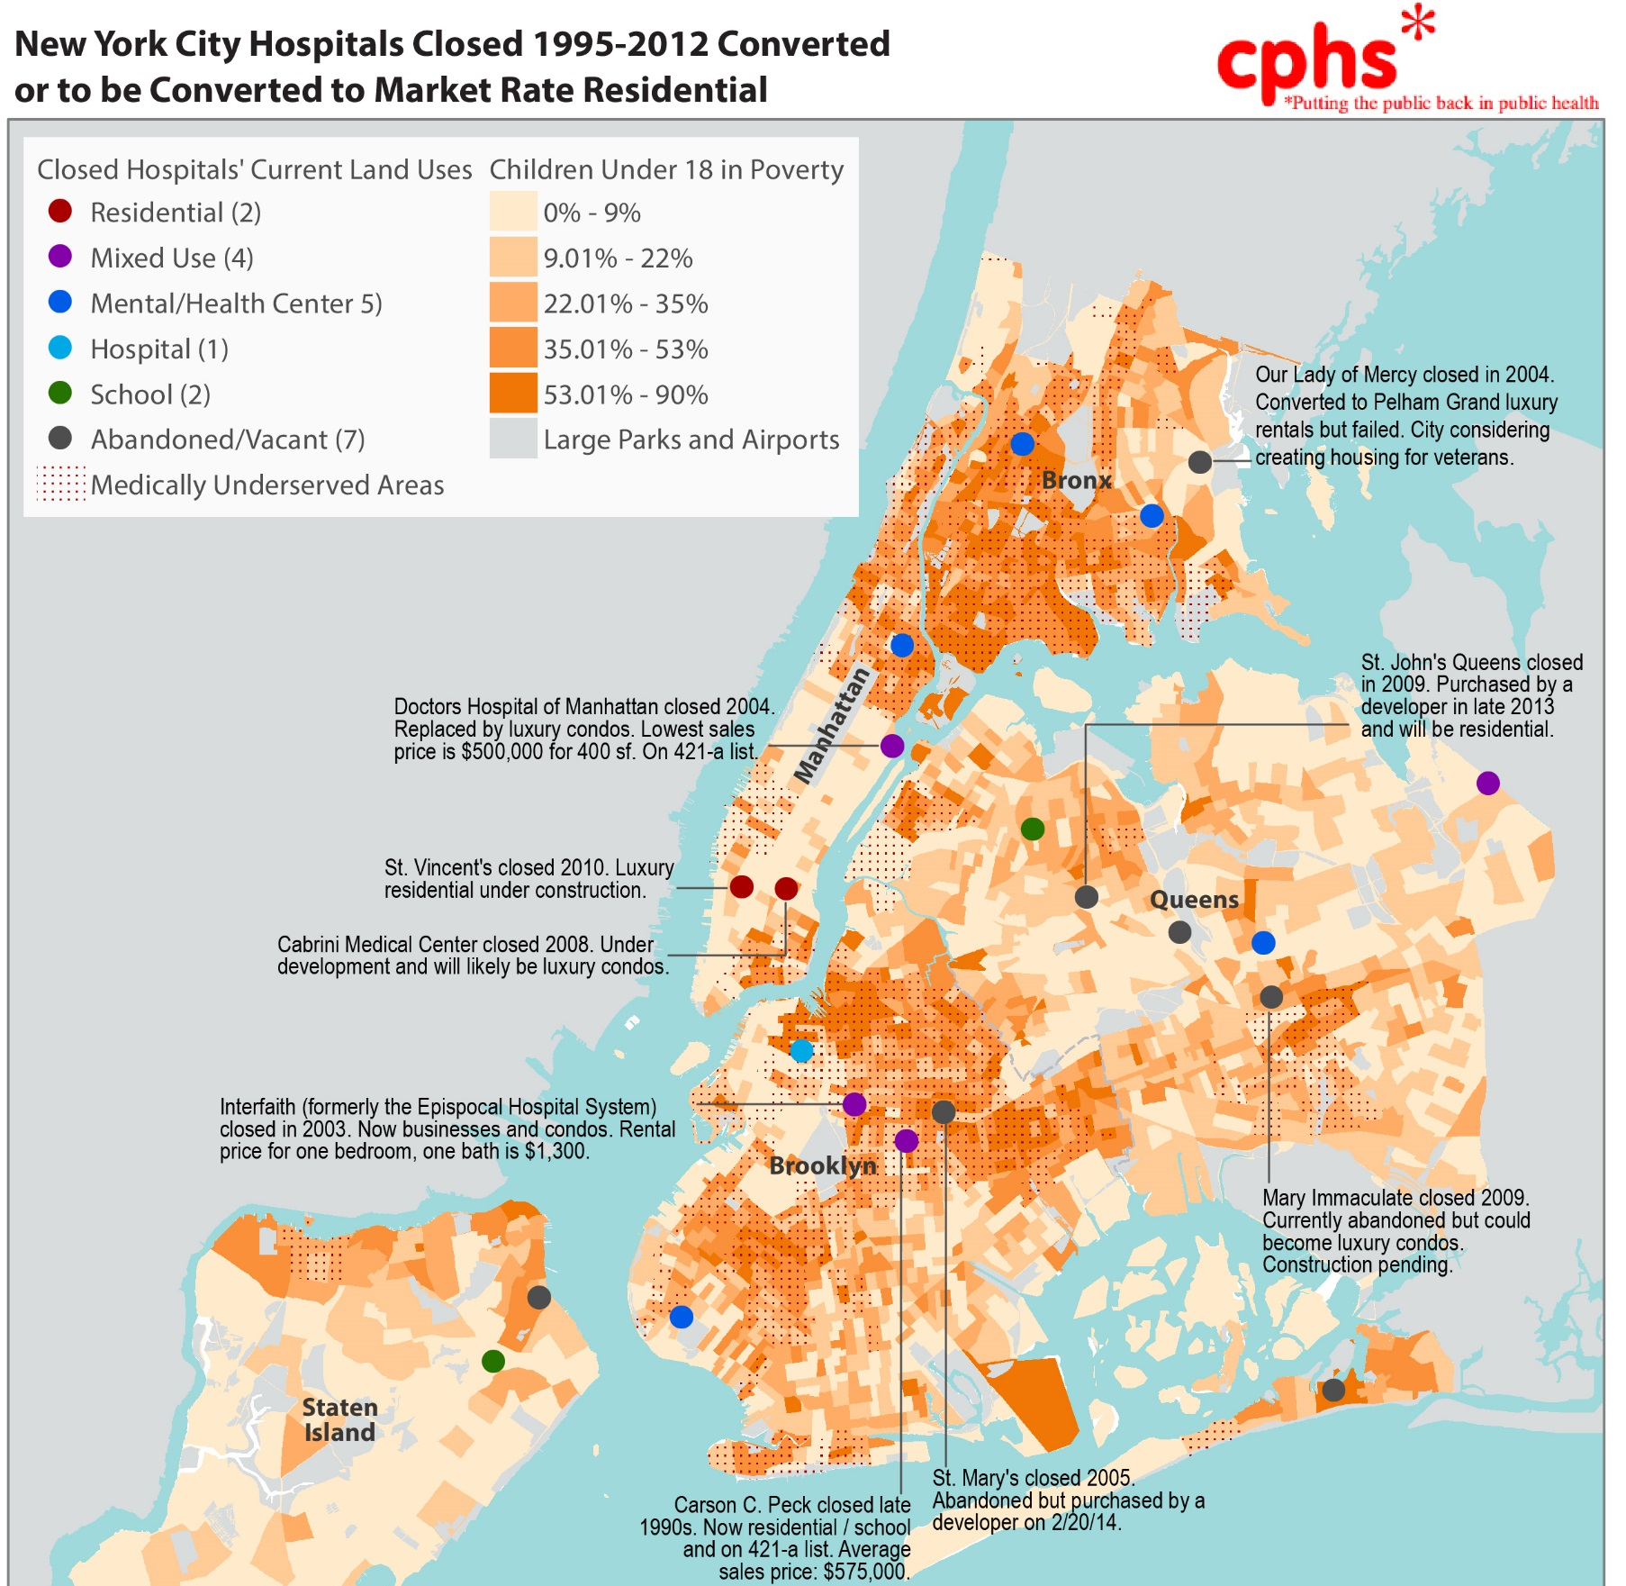

Slide 19
Visualization and cartography

Slide 20
First thing:
Understand your data

Slide 21
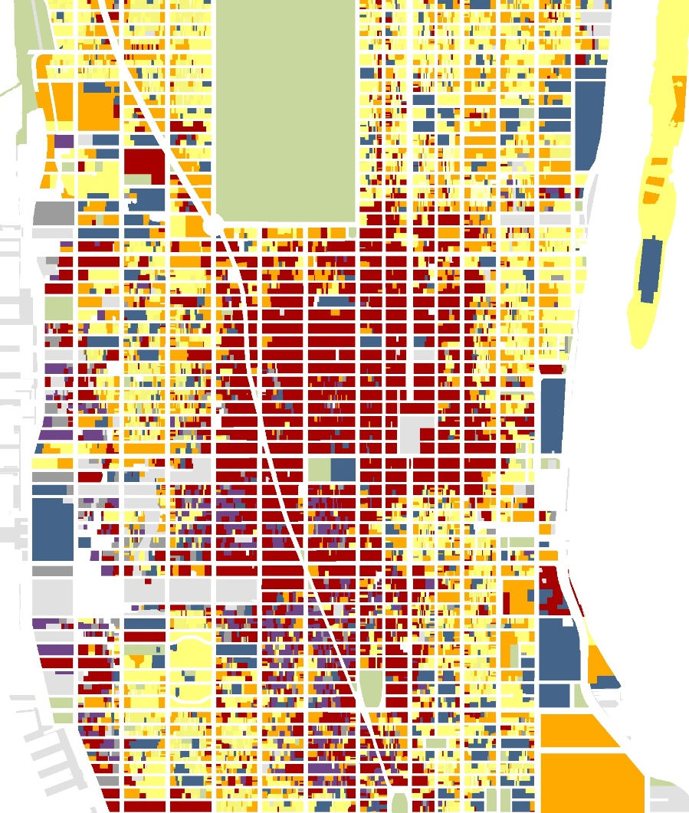
Question everything
What is Mappluto, really?

Slide 22
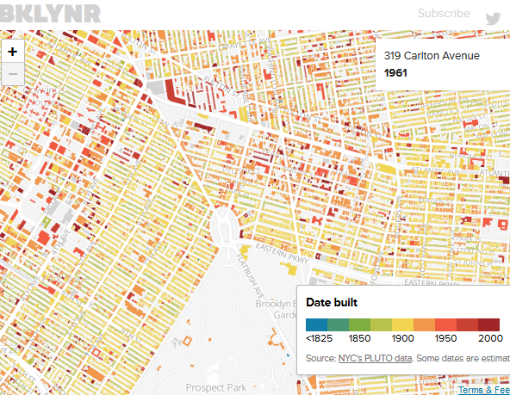
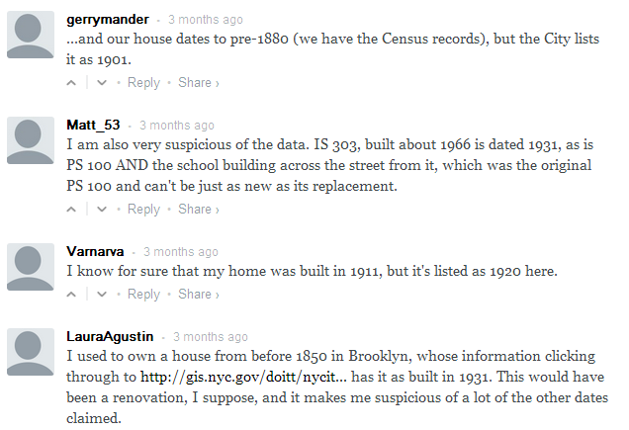
mAPPLUTO
http://bklynr.com/block-by-block-brooklyns-past-and-present

Slide 23
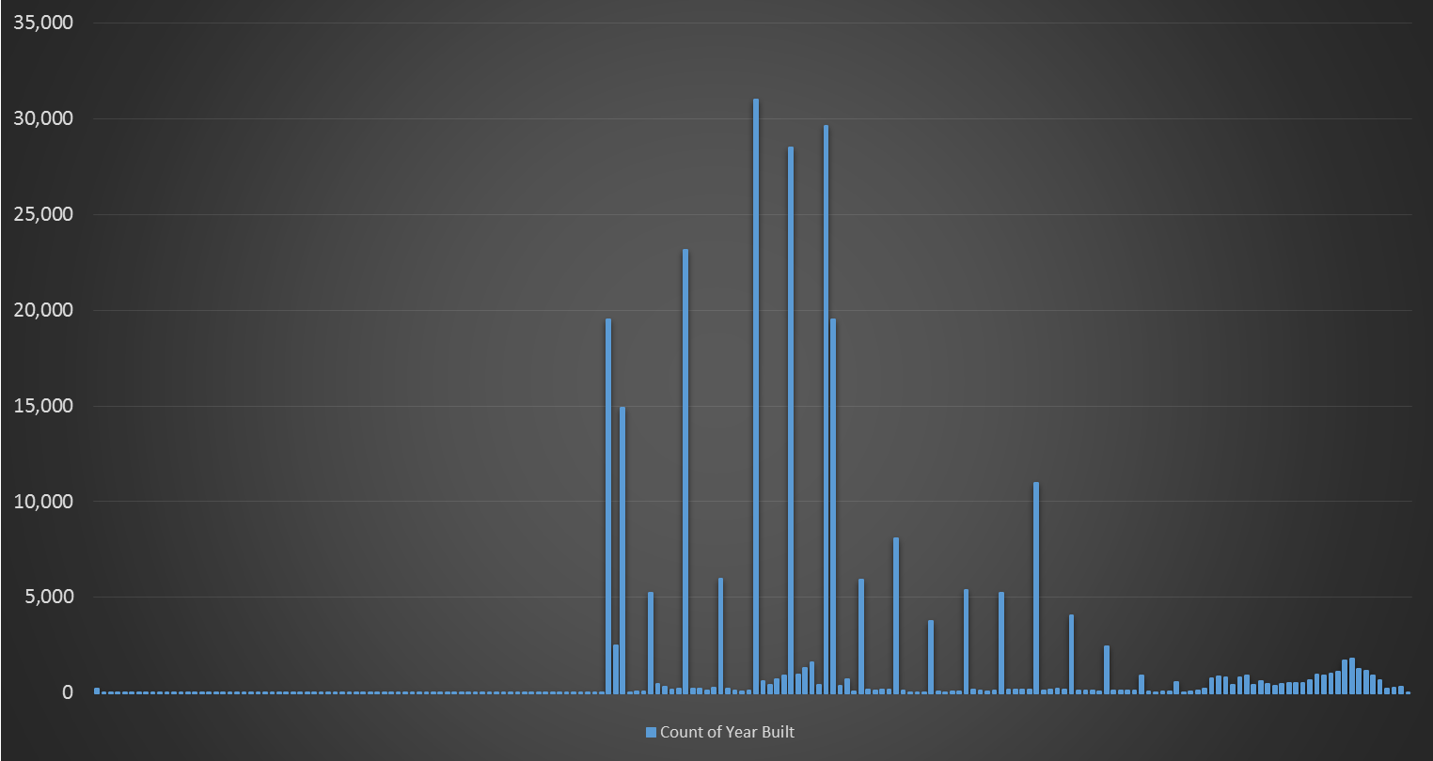
MAPPLUTO
1920
1930
Year built/
Altered field
1910
1899
...guess these
‘spike’ years
1800
2013
Notes:
5% of records are blank 76% of records that have a year are estimated

Slide 24
mAPPLUTO
Metadata: read it
53 pages of essential information
http://bklynr.com/block-by-block-brooklyns-past-and-present

Slide 25
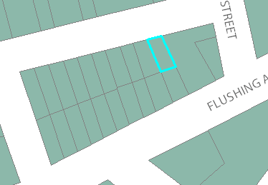
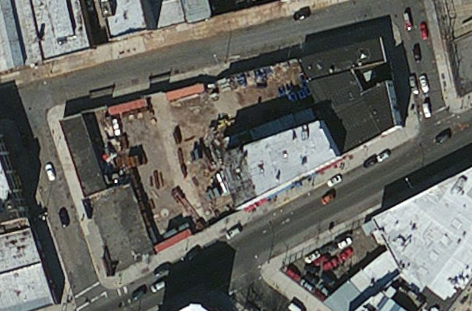
mAPPLUTO
Number of buildings field
This tax lot has 236 buildings

Slide 26
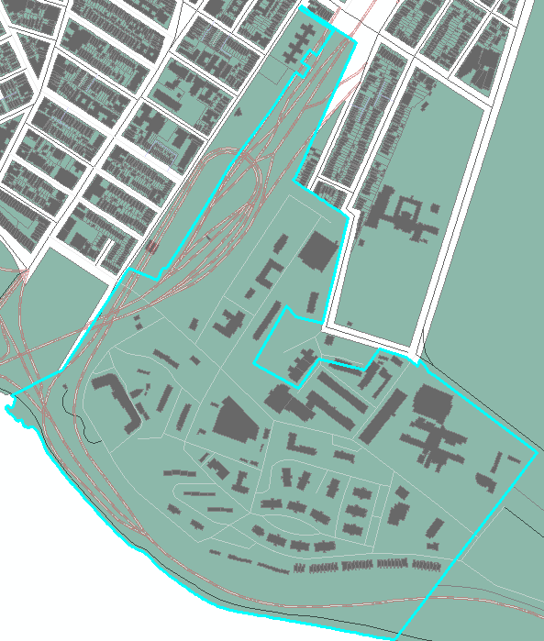
mAPPLUTO
Number of
buildings field
This tax lot has 123 buildings
Notes:
Ft Hamilton BK Army

Slide 27
data classification

Slide 28
data classification
Quantiles: puts the same number of observations into each class. Ignores the range.
Equal-Interval: divides the range into an equal number of classes. Ignores the number of observations.
Natural-Breaks: maximizes the inter-group variance while minimizing the intra-group variance. Like things are clumped together.
Standard Deviation: groups data in classes based on the mean and distance from the mean.
Unclassified
Manual: DIY
****mapping absolute values – be careful!

Slide 29
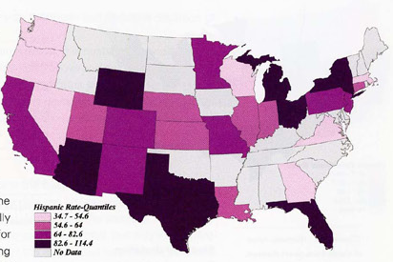
data classification
Quantiles: put the same number of observations into each class. Ignores the range.
Classes are formed by sorting the data values into ascending order and dividing them into 5 equal batches.
Will never have empty classes.
But, it might look great but can often
place similar values in different
classes or different values in the same
class. Bad if data is skewed.

Slide 30
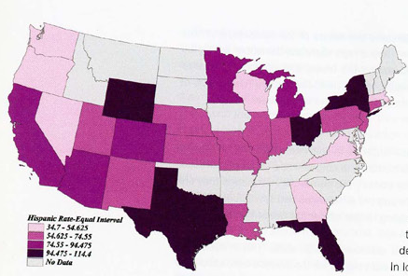
data classification
Equal-Interval: divides the range into an equal number of classes. Ignores the number of observations in each class.
Example:
1-20
21-40
41-60
61-80
81-100
Very straightforward for the viewer.
Useful if the data values are evenly spread throughout the range.
If data is skewed, some of the classes will contain most of the data and any spatial patterns are lost.

Slide 31
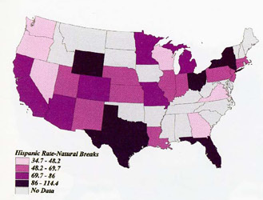
data classification
Natural-Breaks: maximizes the inter-group variance while minimizing the intra-group variance. Like things are clumped together.
Is appropriate for most data because it uses a statistical formula to find breaks that are inherent in the data.
Good for skewed data.

Slide 32
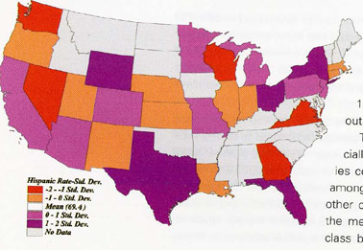
data classification
Standard Deviation: groups data in classes based on the mean and distance from the mean.
Each class represents one (or a half) standard deviation above of below the mean.
Useful for longitudinal studies.
Useful when comparing data of
different topics (or if the data
varies wildly in the means).

Slide 33
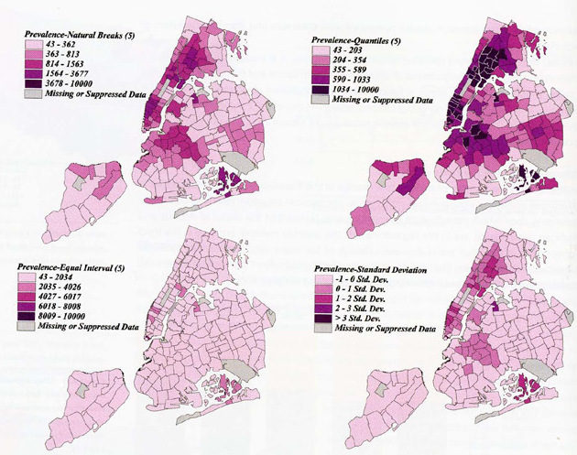
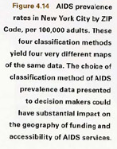
data classification

Slide 34
normalizing data

Slide 35
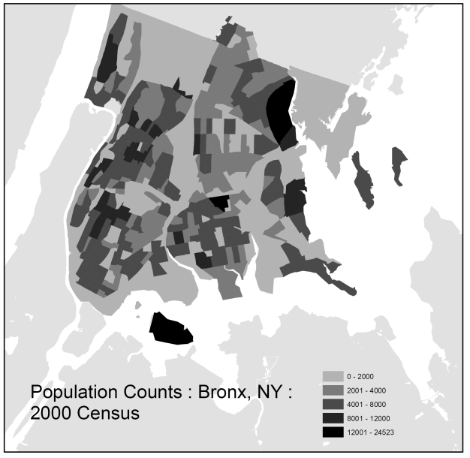
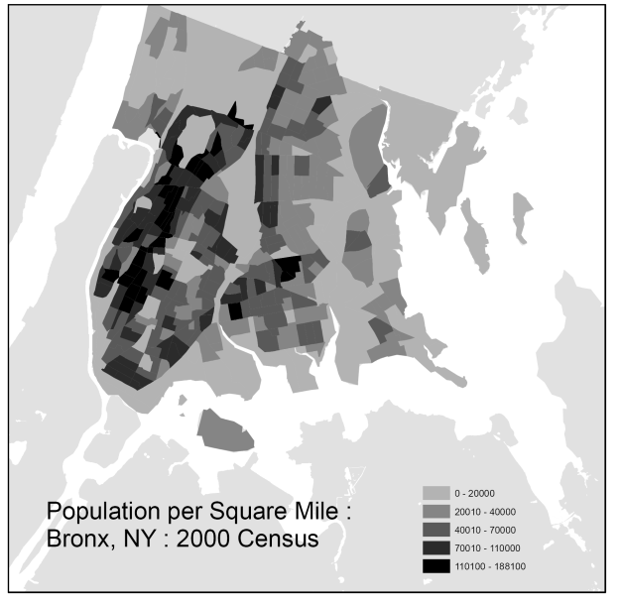

Slide 37
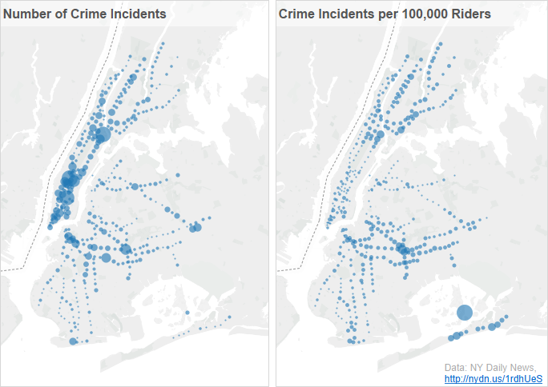
https://eagereyes.org/basics/putting-data-into-context
Notes:
http://www.nydailynews.com/new-york/nyc-crime/daily-news-analysis-reveals-crime-rankings-city-subway-system-article-1.1836918

Slide 38
cartography

Slide 39
cartography
design
- what is the goal of the map?
- who is the intended audience?
- what media will the map be displayed on?
- what is the appropriate scale for the map?
- does the data need to be simplified in order to display at the requested scale?
are there legal constraints in the display or distribution of the data to be
included on the map?

Slide 40
cartography
Emphasize in the foreground:
The boundary of your area of interest (labeled)
Named places, and other features related to your argument (labeled)
Fade into the background:
Major transportation features.
Administrative boundaries of interest.
Other layers that may help viewers orient themselves like parks, water, etc.
Named places, large parks, water bodies (optional).

Slide 41
cartography
Colors and symbols should reflect the importance of each layer. For example, borough boundaries can often be made gray. Less important layers should fade into the background.
By regulating the brightness and line weights in the portrayal of specific features, you help the reader comprehend the map.
Elements like north arrow and scale bar can be made smaller and gray.
Stay away from bold, primary colors if possible. Color choice greatly affects the professional appearance of the map.
Background map elements should be displayed in muted, non-distracting colors.

Slide 42
Bad maps!

Slide 43
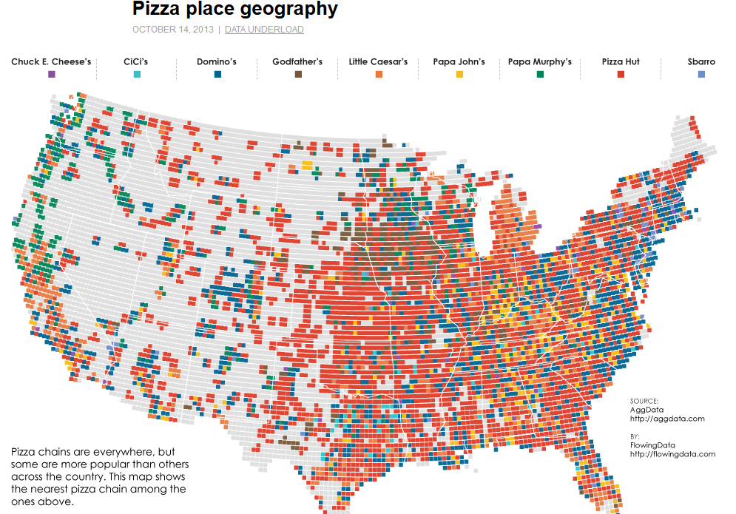
Maps without meaning
Notes:
http://flowingdata.com/2013/10/14/pizza-place-geography/

Slide 44
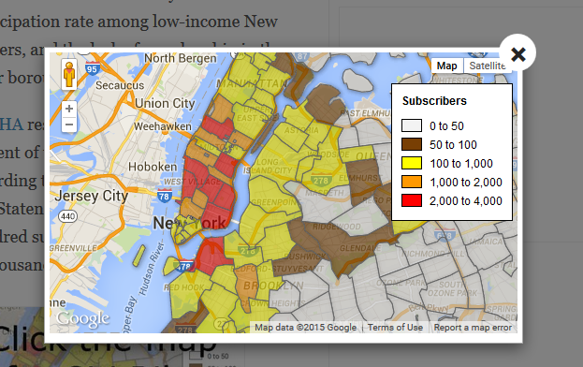
Incorrect data representation
http://dnain.fo/1yiE4Et

Slide 45
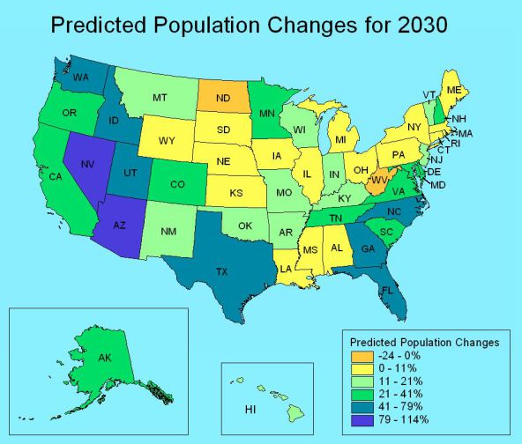
Divergent color scheme
https://cartastrophe.wordpress.com/page/5/
Notes:
https://cartastrophe.wordpress.com/page/5/

Slide 46
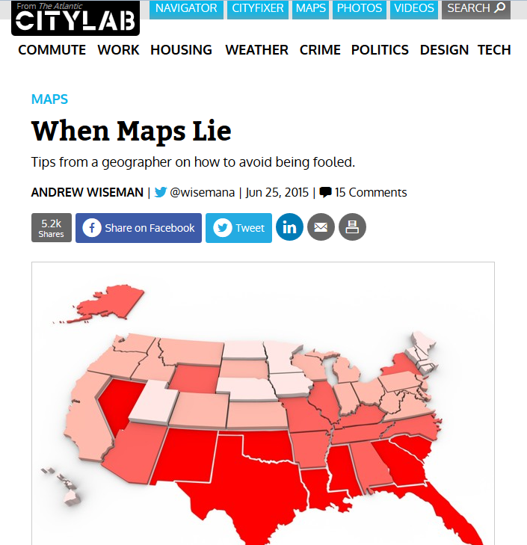
Please consider reading this:
http://www.citylab.com/design/2015/06/when-maps-lie/396761/
Notes:
Good map

Slide 47
Maps in presentations and reports

Slide 48
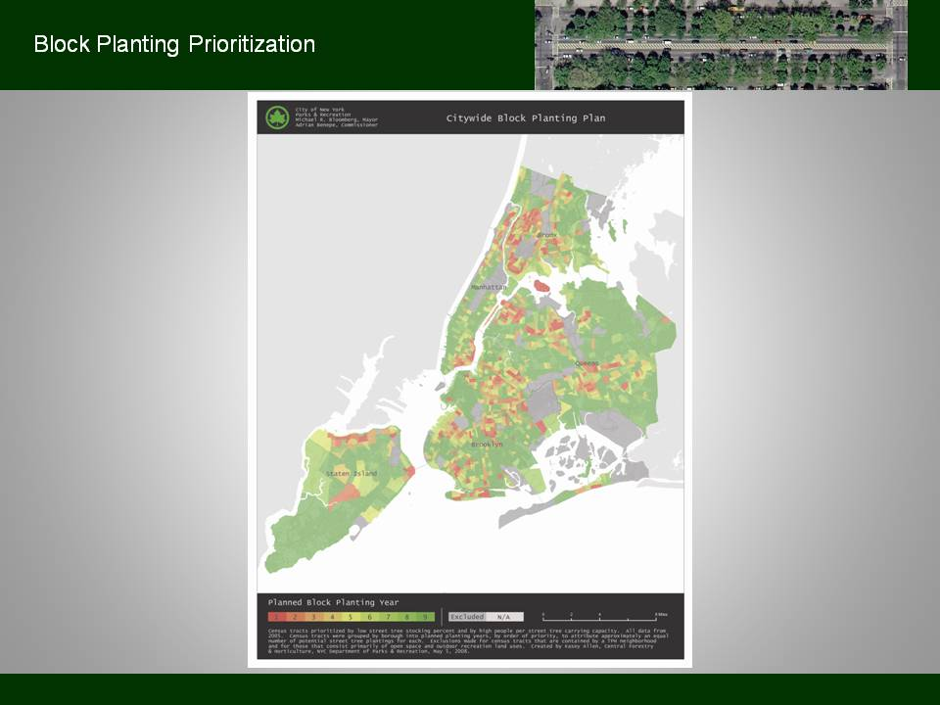
Maps in presentations and reports
No!
Notes:
Do not do this!

Slide 49
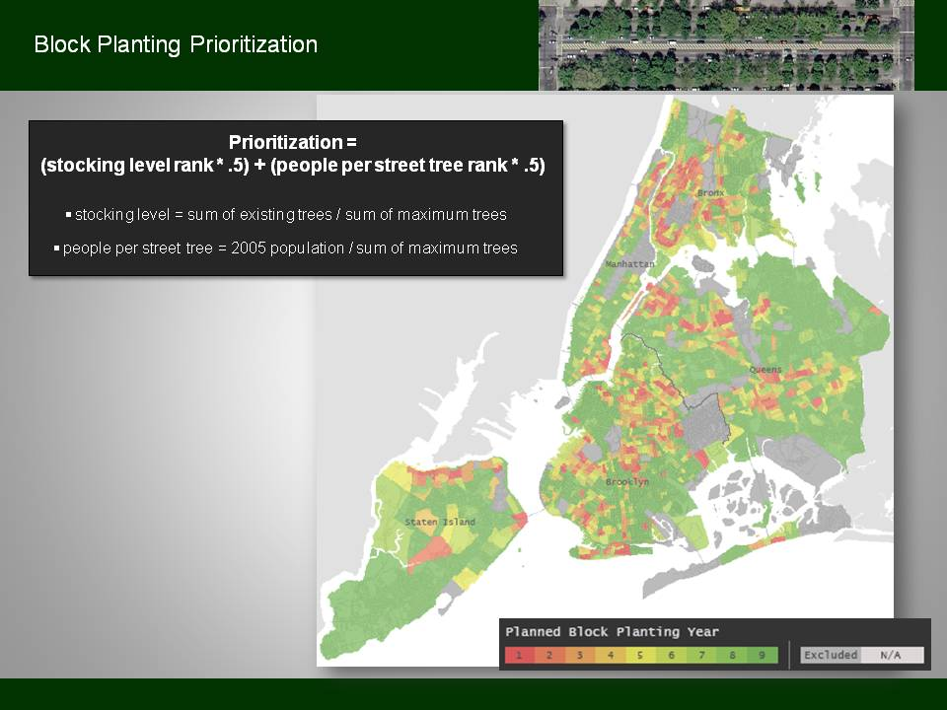
Maps in presentations and reports
Yes!
Notes:
Do this!

Slide 50
Census data

Slide 51
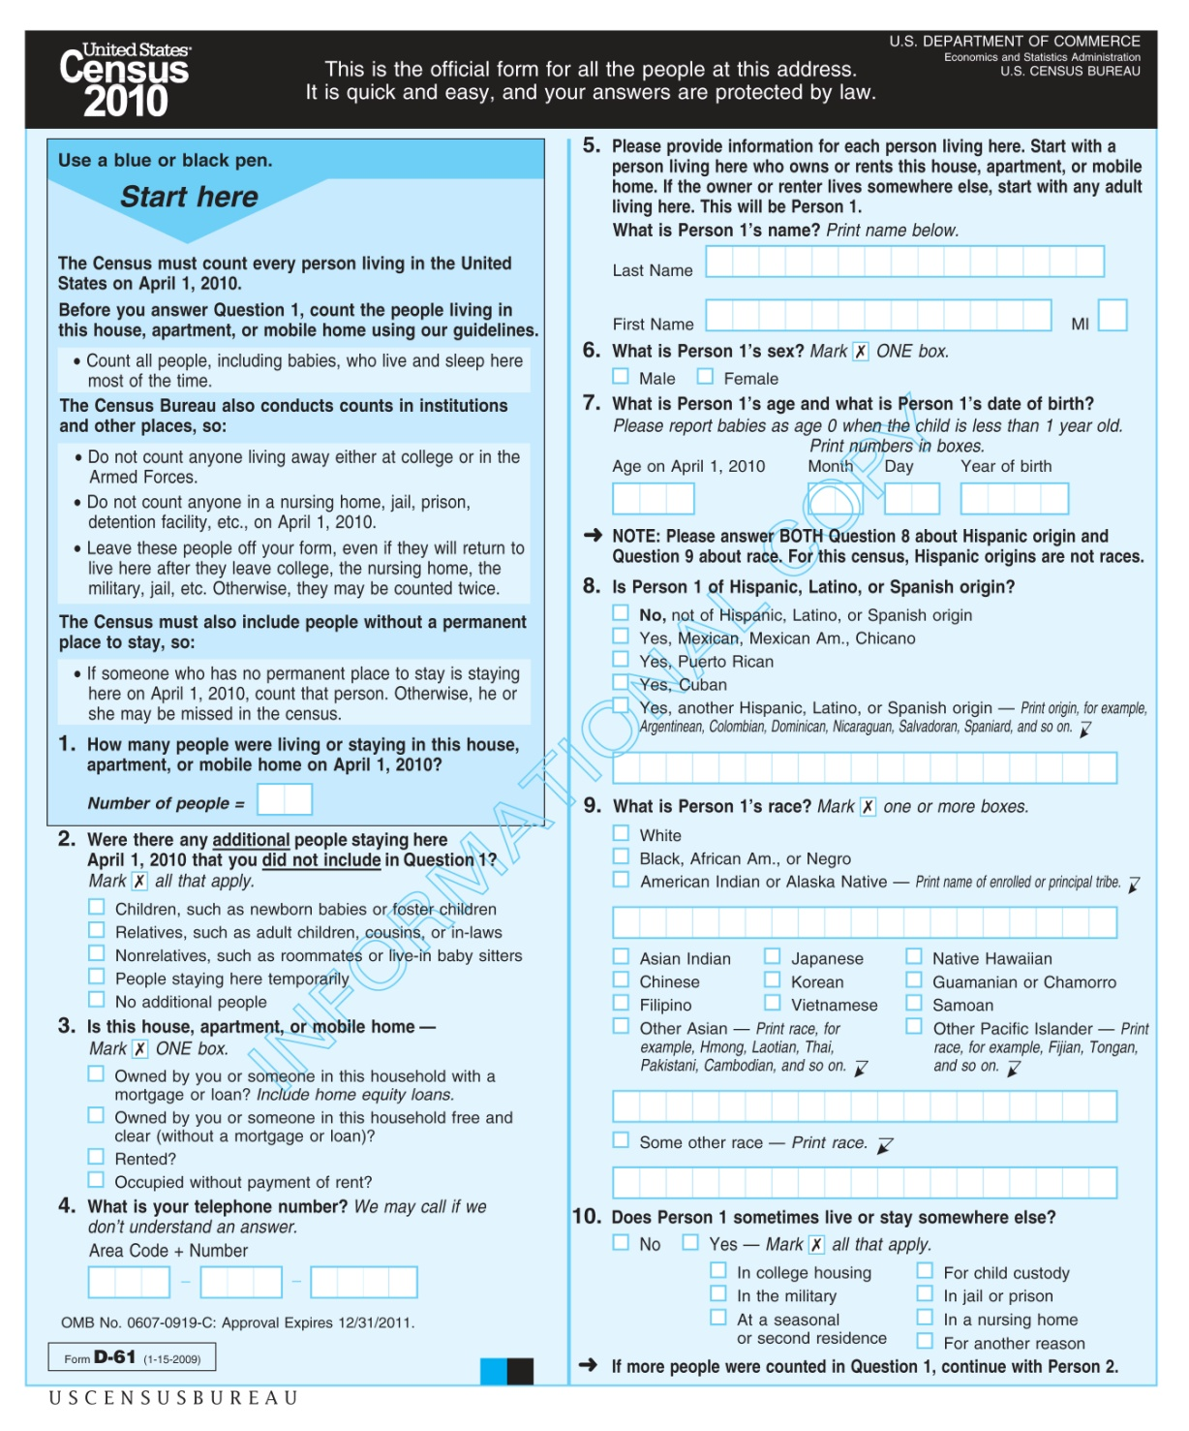
Census
-Decennial vs ACS
-Boundary alignment issues

Slide 52
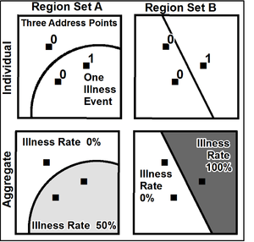
modifiable areal
unit problem (MAUP):
Notes:
http://www.google.com/imgres?imgurl=http://upload.wikimedia.org/wikipedia/en/thumb/a/ab/Maup_rate_numbers.png/300px-Maup_rate_numbers.png&imgrefurl=http://medlibrary.org/medwiki/Modifiable_Areal_Unit_Problem&usg=__PT_EEZ90zi2Qd1B-oFmxlWyrE3Q=&h=286&w=300&sz=48&hl=en&start=0&zoom=1&tbnid=o-AY9tQdQNou0M:&tbnh=119&tbnw=125&ei=nDtYTbTQN8_UgAeArYmsDQ&prev=/images%3Fq%3Dmodifiable%2Bareal%2Bunit%2Bproblem%2Bexample%26um%3D1%26hl%3Den%26client%3Dfirefox-a%26sa%3DN%26rls%3Dorg.mozilla:en-US:official%26biw%3D1330%26bih%3D485%26tbs%3Disch:1&um=1&itbs=1&iact=hc&vpx=116&vpy=174&dur=386&hovh=219&hovw=230&tx=118&ty=75&oei=DztYTaP4EcL-8AbiupGnBw&page=1&ndsp=27&ved=1t:429,r:9,s:0

Slide 53
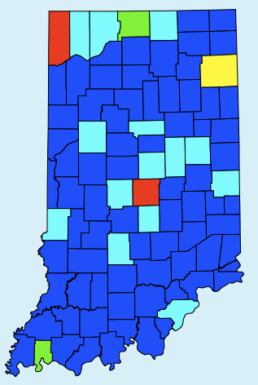
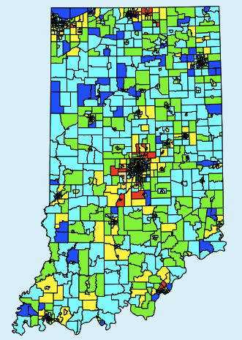
modifiable areal unit problem (MAUP): Scale
Notes:
http://www.cartographica.com/article.php?story=20110519191620965
The first map shows the distribution of households across counties in the state of Indiana. Using the Natural Breaks reclassification method one can see that there is not much variation in the distribution of raw household counts across the state. Higher levels of households appear to be concentrated in only a few places.
However, when one views the Census tract map it is clear that there is much more variation across the state with smaller units of analysis. It is easy to see that evaluating the impact that the number of households would be greatly impacted based on the scale of the evaluation.

Slide 54
Census resources

Slide 55
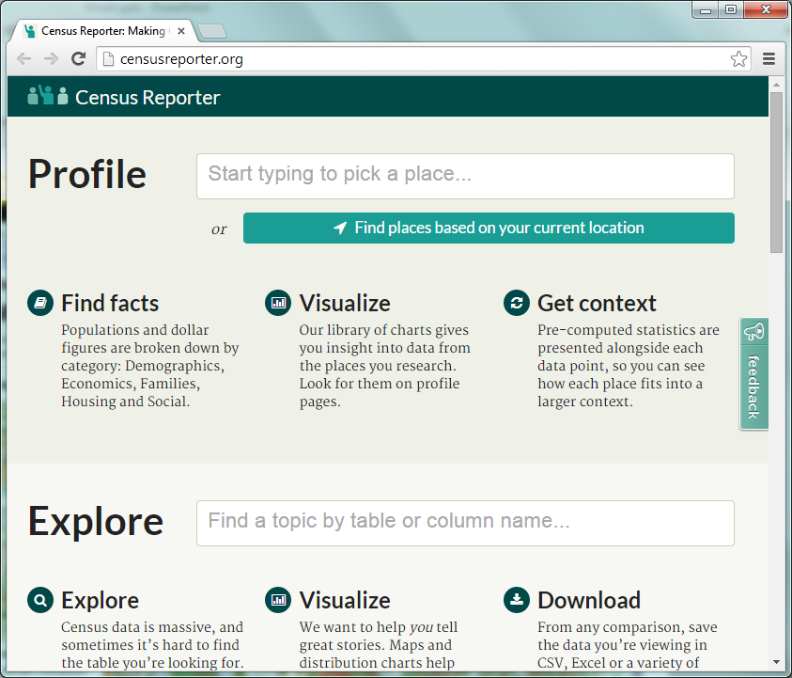

Slide 56
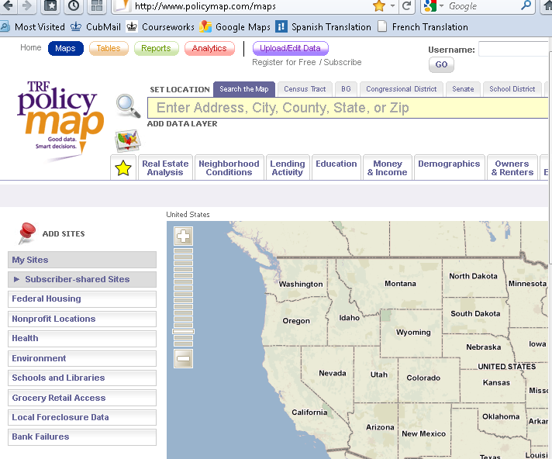

Slide 57
Interactive maps for NYC context

Slide 58

http://nyc.pediacities.com/Nycpedia

Slide 59
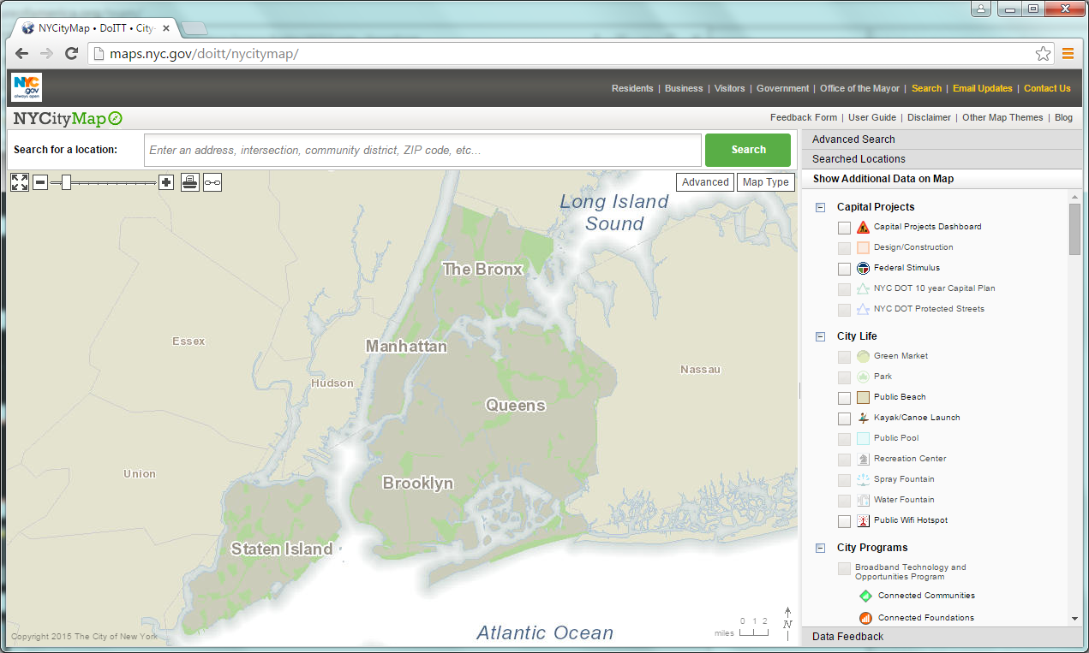
http://maps.nyc.gov/doitt/nycitymap/

Slide 60
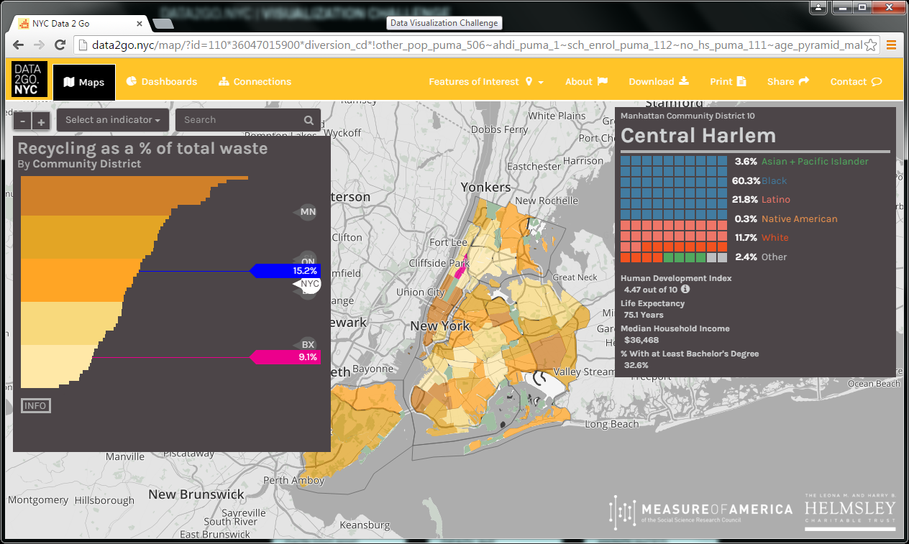
http://data2go.nyc/

Slide 61
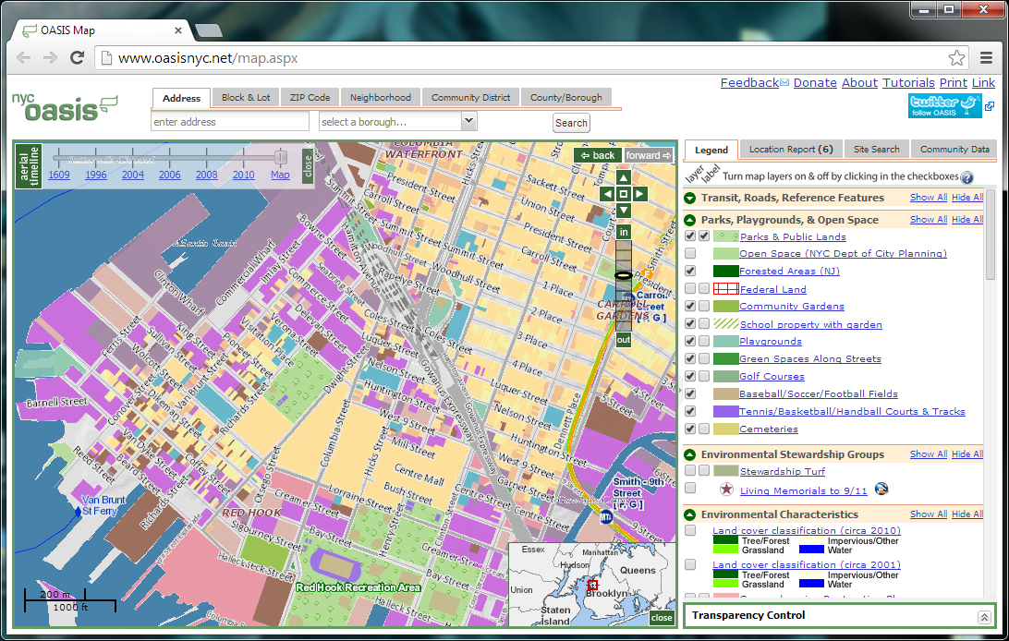
http://www.oasisnyc.net/map.aspx

